Slide 1


Current and Magnetic Fields

Slide 2

Review – Fields around wires
Review – Physics gang signs 1 and 2
Calculating the Magnetic Field around a wire

Slide 3
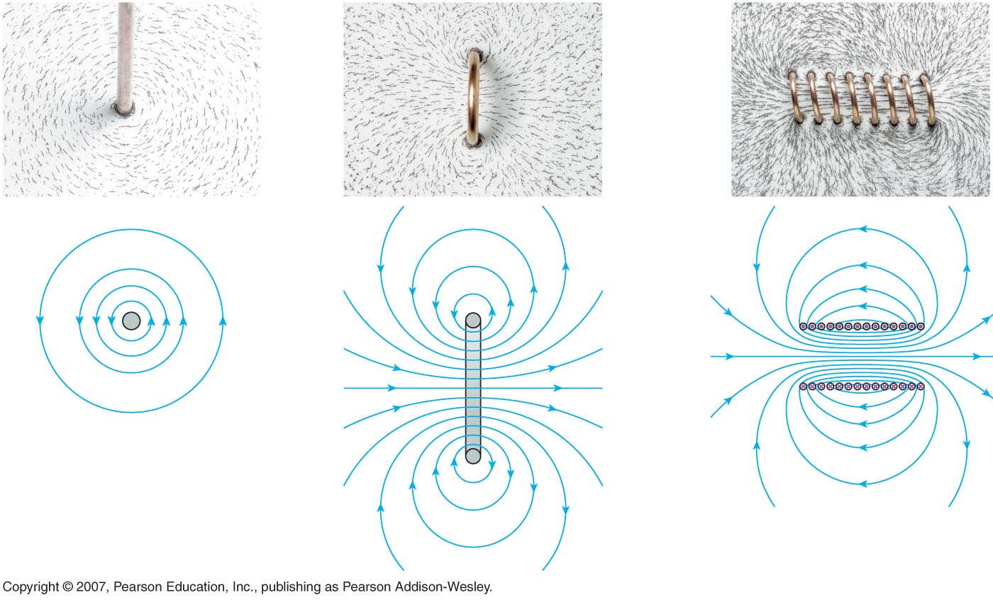
Electric Currents Also Create Magnetic Fields
A long, straight wire
A current loop
A solenoid

Slide 4
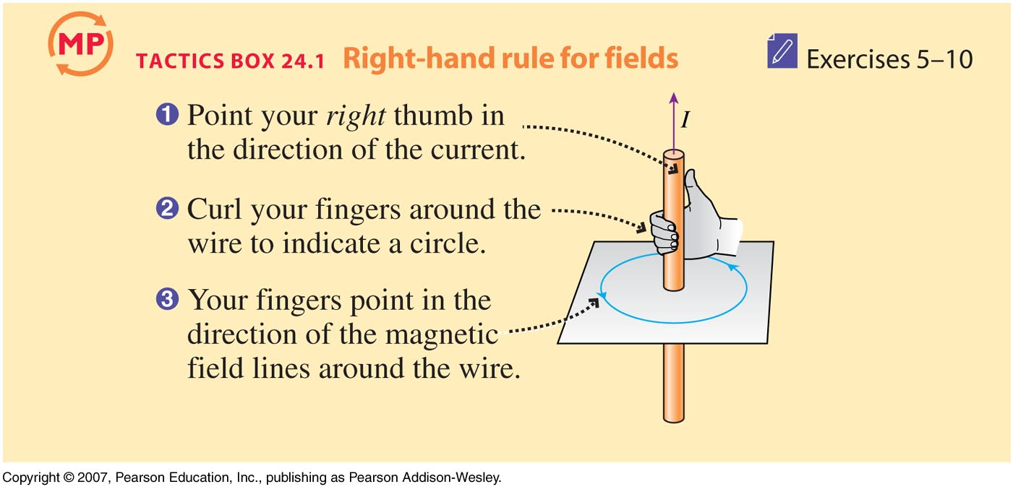
Electric Currents Also Create Magnetic Fields

Slide 5
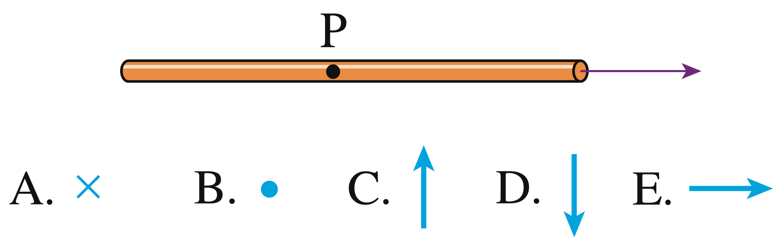
Checking Understanding
Point P is 5 cm above the wire as you look straight down at it. In which direction is the magnetic field at P?
Notes:
Answer: D

Slide 6

Answer
Point P is 5 cm above the wire as you look straight down at it. In which direction is the magnetic field at P?
Slide 24-20
Notes:
Answer: D

Slide 7
The Magnitude of the Field due to a Long, Straight, Current-Carrying Wire
$$μ_{0}=magnetic permeability of free space$$
$$μ_{0}=4\text{π} × {10}^{–7} N A^{–2} or = 1.26 × {10}^{–6} N A^{–2}$$

Slide 8
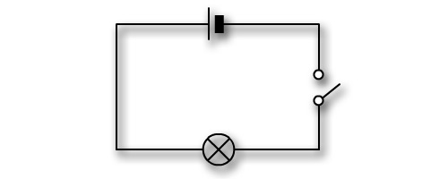
Checking Understanding
Point A is 5 cm to the left the wire as you look straight down at it. The wire carries 0.325 A of current. What is the field strength and direction at A?
Ignore any fields produced by the other wires.
A
Notes:
Answer: D

Slide 9
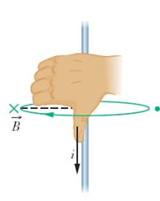

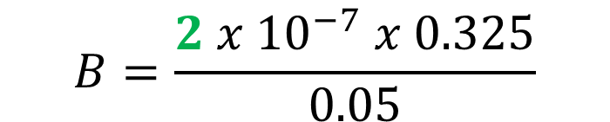
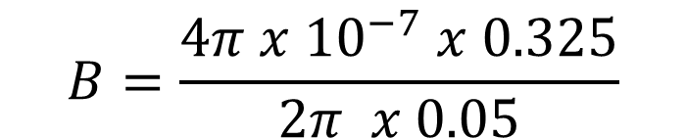
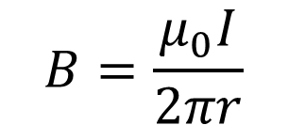
Answer
Point A is 5 cm to the left the wire as you look straight down at it. The wire carries 0.325 A of current. What is the field strength and direction at A?
Ignore any fields produced by the other wires.
$$B=\frac{μ_{0}I}{2πr}$$
+ -
A
$$B=\frac{4π x {10}^{−7} x 0.325}{2π x 0.05}$$
$$B=\frac{2 x {10}^{−7} x 0.325}{0.05}$$
$$B=1.30 x {10}^{−6} T$$
Into the page (screen)
Notes:
Answer: D

Slide 10
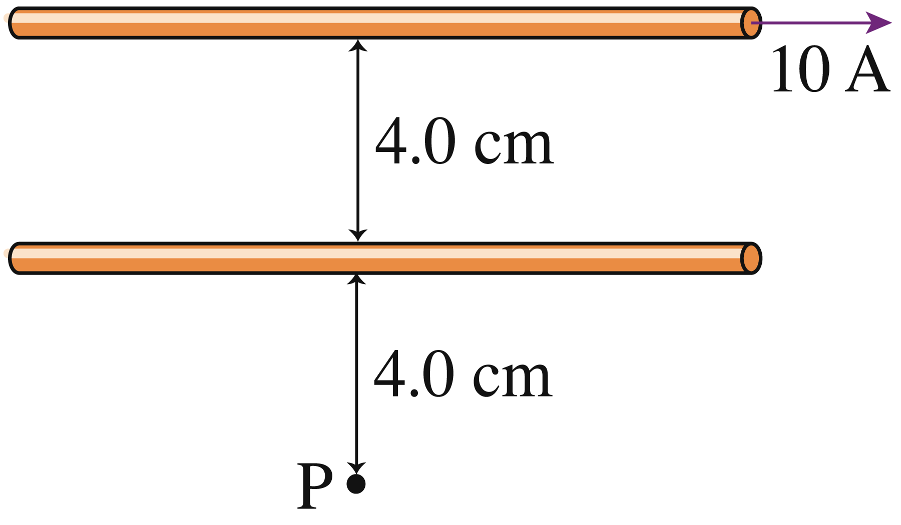
Checking Understanding – Two Wires
The magnetic field at point P is zero. What are the magnitude and direction of the current in the lower wire?
10 A to the right.
5 A to the right.
2.5 A to the right.
10 A to the left.
5 A to the left.
2.5 A to the left.
Notes:
Answer: E

Slide 11
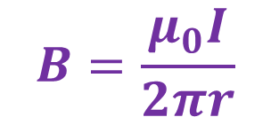
Checking Understanding
5 A to the left.
The magnetic field at point P is zero. What are the magnitude and direction of the current in the lower wire?
Why?
The fields must cancel out.
Therefore currents must be in opposite directions.
Why is the second current half?
$$B=\frac{μ_{0}I}{2πr}$$
Radius is half, but B is inversely proportional.
Therefore only half current needed.
Notes:
Answer: E

Slide 12
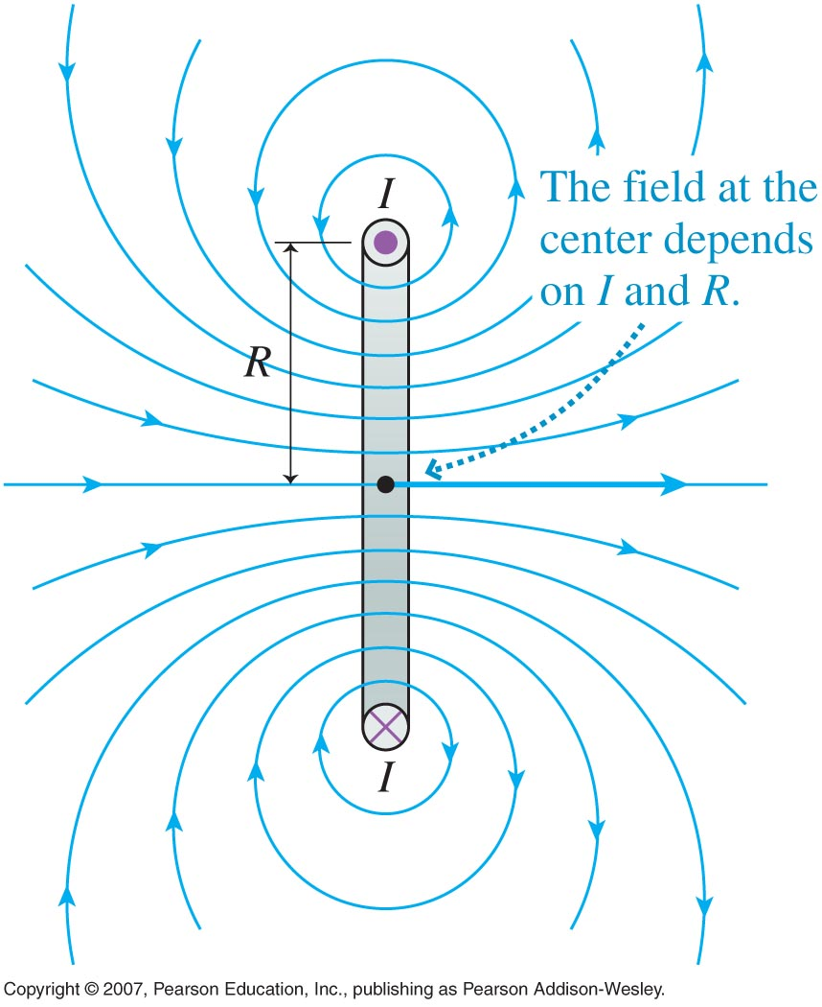
Extension - The Magnetic Field of a Current Loop
Magnetic field at the center of a current loop of radius R
Magnetic field at the center of a current loop with N turns

